Slide 1
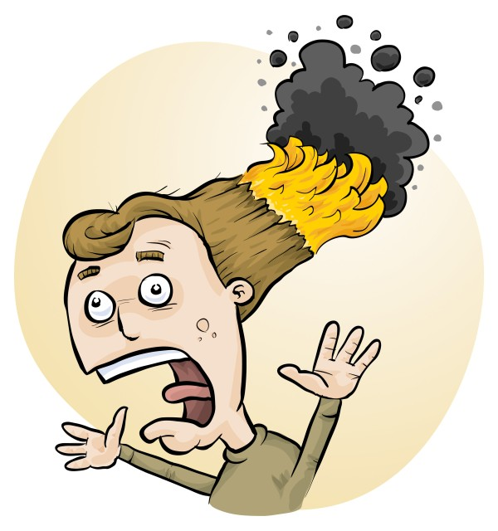
RiskAssess software: hazard information, WHMIS labels, disposal advice and risk assessments for safe laboratories!
Phillip Crisp and Eva Crisp

Slide 2
Why do risk assessments?
reduced frequency of injuries
reduced costs for paperwork, litigation and payouts
compliance with the law: OHS Act + OHS Regulations + WHMIS 2015
better legal position, in the event of litigation

Slide 3
Planning for safety
. . . . . . . .
What are the hazards?
What safety precautions are needed?
What safety routines and equipment need to be reviewed or checked?
Is the room appropriate for the activity . . . ?
Can risk be kept to an acceptable minimum?
. . . . . . . .
Do I know how to safely dispose of the waste generated during the activity?
Safe ON Science, 2nd ed., 2018; Section 3.1 “Safety and lesson planning”

Slide 4
Hazards
A hazard is anything in the workplace that could hurt you
or the people you work with.
[Ontario Ministry of Labour Training and Skills Development “Health and Safety at Work”]
The Occupational Health and Safety Act (1990) imposes duties on employers to "acquaint a worker . . . with any hazard in the work and in the handling, storage, use, disposal and transport of any article, device, equipment or a biological, chemical or physical agent . . . prepare and review at least annually a written occupational health and safety policy and develop and maintain a program to implement that policy" [25(2)(d),(j)].

Slide 5
Hazard and Risk CA, US AU, NZ, UK, ISO
Sometimes a distinction is made between hazard and risk:
risk is a function of hazard and exposure time
Often, the words are used interchangeably.
In the school situation, exposure time is not usually relevant.
International Organisation for Standardization (ISO) 3100:2018 Risk Management
Canada is a signatory to the ISO Convention (full member).

Slide 6
Conduct a Risk Assessment Evaluation
It is often possible to reduce the risk (risk is a function of hazard and exposure time) of using a hazardous chemical to an acceptable level by adopting suitable control measures.
Safe ON Science, 2nd ed., 2018; Section 7.3 “Hazardous chemicals”

Slide 7
You should:
identify
assess
control
risks
Before: Establish the context
After: Monitor and review
Always: Consult and communicate

Slide 8
Risk identification
• history of “accidents” and “near-accidents”
- at school - at similar schools
• brainstorming, preferably with colleagues
• checklists of possible risks
• authoritative sources e.g. SDSs, databases
• consider facilities, e.g. fume cupboard
• consider student behaviour, allergies, special needs
• . . . . . . . . . .

Slide 9
Risk assessment
To assess the severity of a risk,
you need to consider:
• the consequences of the event, and
• the chance that it will occur (likelihood)
ISO 31000:2018 “Risk management”
Risk matrices used in schools are 3 x 3 to 5 x 5
See www.riskassess.ca/info/learning_resources

Slide 10
Risk control
Hierarchy of options:
elimination
substitution
isolation
engineering
administration
personal protective equipment

Slide 11
Assess risks
≥Medium
risk level
Low
risk level
Add control measures
DO
EXPERIMENT
Inherent level of risk
= risk level without any control measures besides “routine procedures”
Residual level of risk
= risk level with control measures in place

Slide 12
What is RiskAssess? www.riskassess.ca
• web-based risk assessment tool
• customized to the school situation
• customized to Canada
• quick and easy to use!

Slide 13
RiskAssess provides:
• electronic templates (CA/ISO)
• database information on risks (chemical, equipment, biological)
• GHS labelling (WHMIS 2015)
• chemical disposal advice
• prac ordering and scheduling
• extensive learning resources

Slide 14
Does RiskAssess work?
World-wide:
2,700 schools
6.5 million risk assessments
16 years

Slide 15
2700 schools AU: 2400 (84%) NZ: 300 (54%) CA: 60 (1%)
590 schools
200 schools
80 schools

Slide 16
Does RiskAssess work in Canada?
60 schools
43,000 risk assessments
(including Calgary Board of Education high schools for 12 years)
6 schools Calgary/Red Deer/Edmonton

Slide 17
Logic of RiskAssess
• safety information customized for school labs: 3500 chemicals and solutions 2000 equipment items 1500 biological items
• initial assessment of inherent risk - if low, go to end of assessment - if medium or more, record control measures - if high or extreme, third reviewer required
• labelling for WHMIS 2015 (for whole school)
• chemical disposal advice (for whole school)
• learning resources
• inexpensive ($350 per school campus per year)

Slide 18
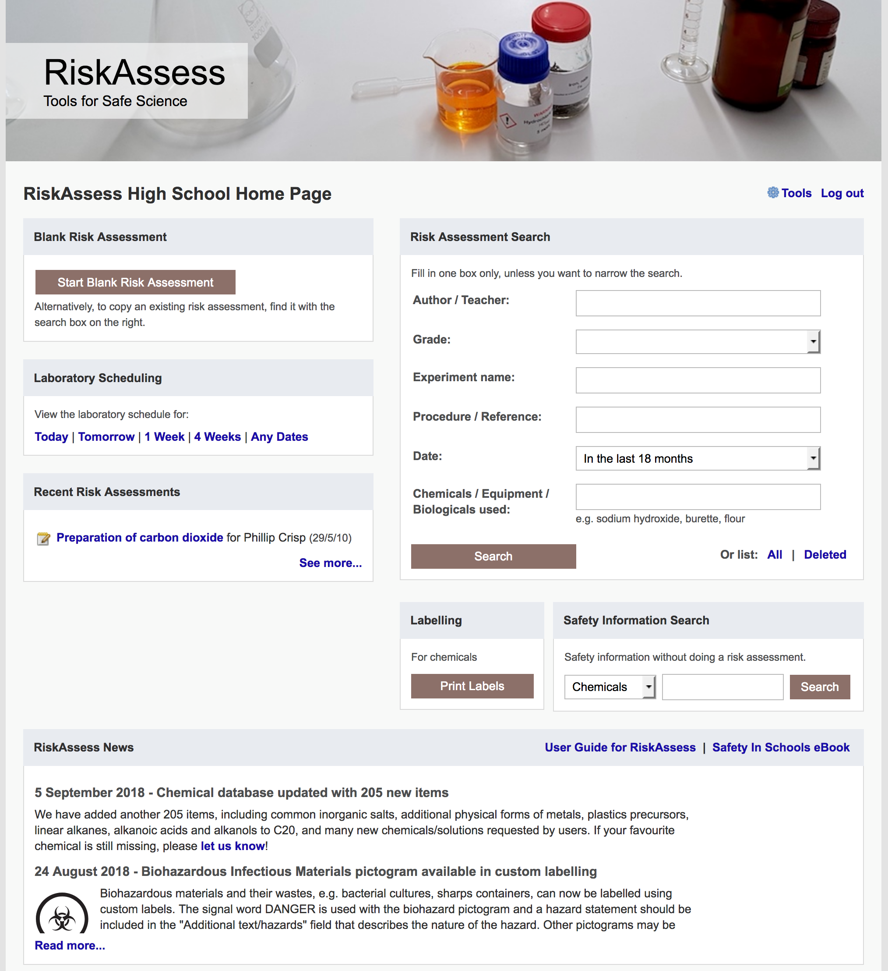
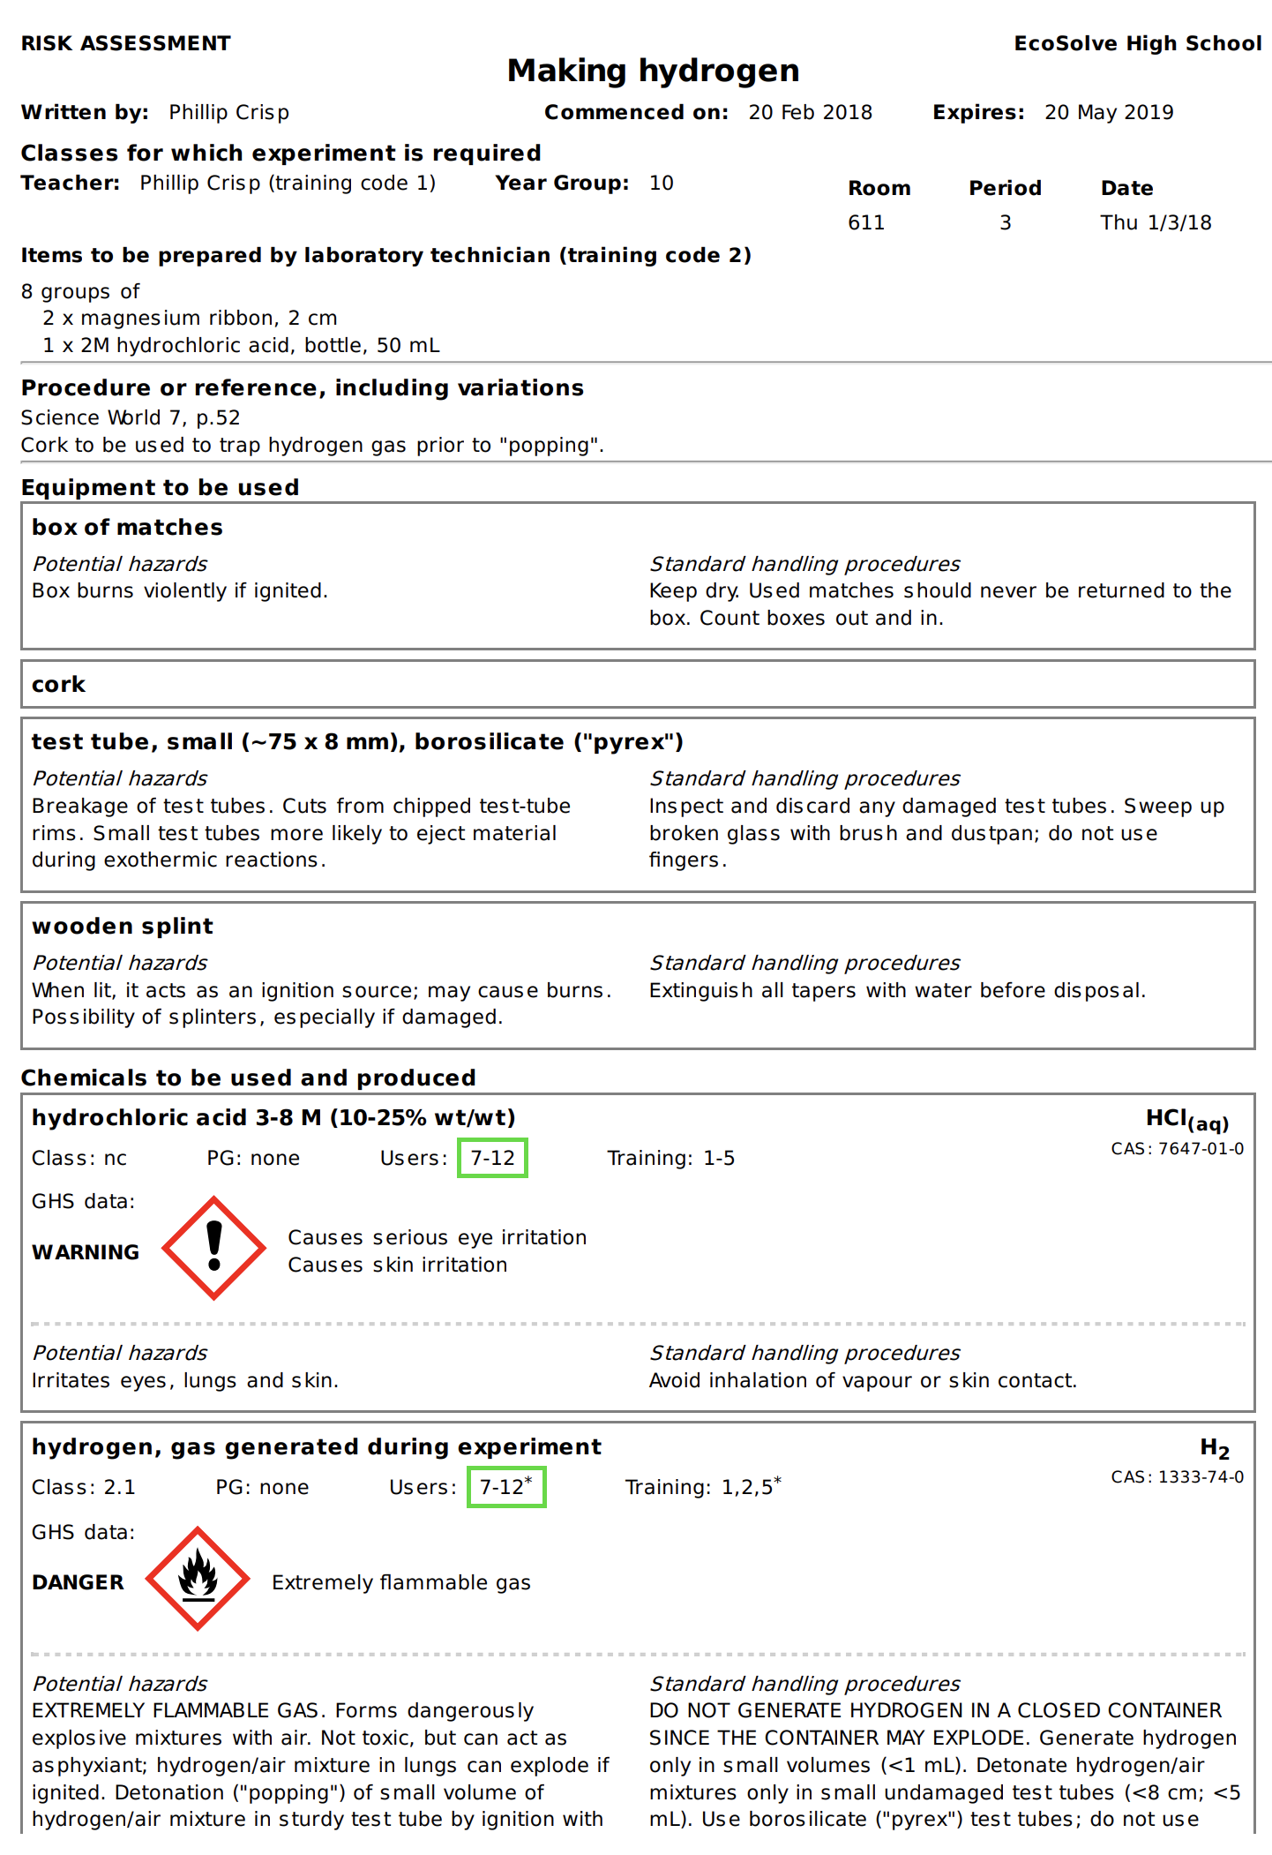

Slide 19
Details
access from school/home
nothing to install on computer, tablet or phone (instant update)
unlimited number of simultaneous users and risk assessments
minimal data entry
complements SDSs
continuing input from science staff
multiple backups of data & backup server
support and advice

Slide 20
Advantages of RiskAssess
proper consideration of risks and control measures
standardization in school and between schools
storage of records for legal purposes
WHMIS labelling (for whole school)
waste disposal advice (for whole school)
communication between teachers and science technicians
discourages spur-of-the-moment experiments
useful for new/inexperienced staff

Slide 21
Workplace labels
Required “when a hazardous product is decanted
(e.g. transferred or poured) into another container”
and it is not “going to be used immediately”
In general, a workplace label will require the following information:
• Product name (matching the SDS product name)
• Safe handling precautions, may include pictograms or
other supplier label information
• A reference to the SDS (if available)
Workplace label requirements fall under your Provincial or Territorial jurisdiction . . .
Canadian Centre for Occupational Health and Safety “WHMIS 2015 - Labels” https://www.ccohs.ca/oshanswers/chemicals/whmis_ghs/labels.html

Slide 22
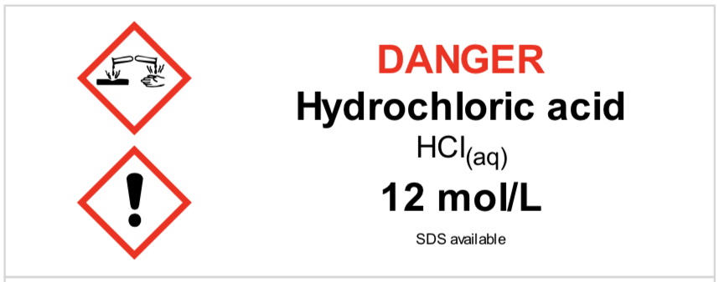
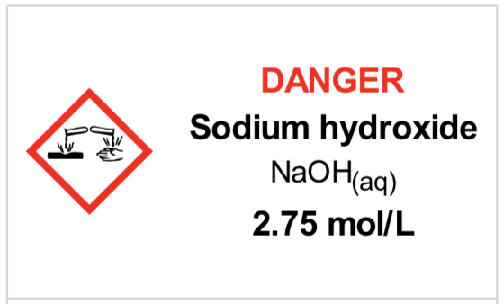
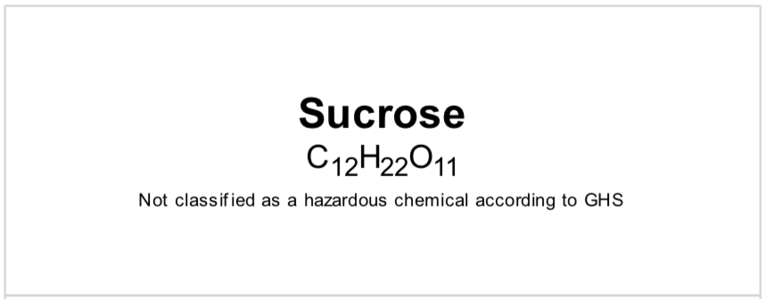
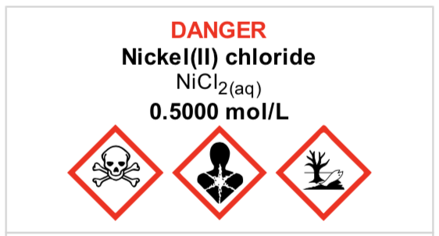
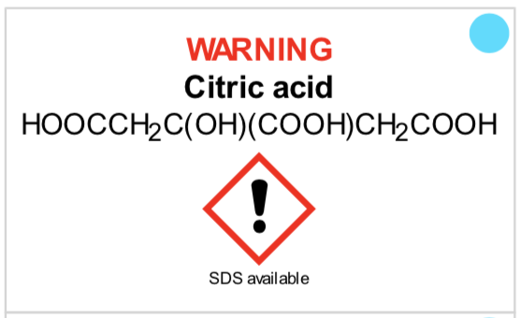
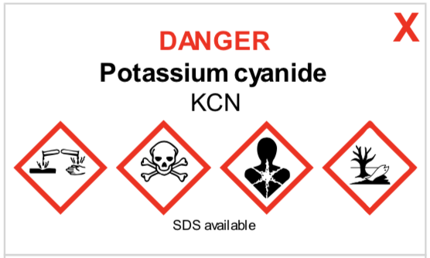
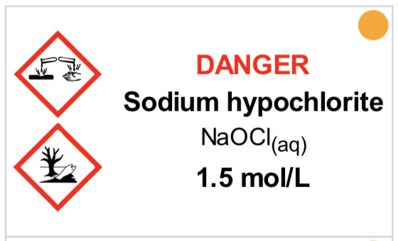
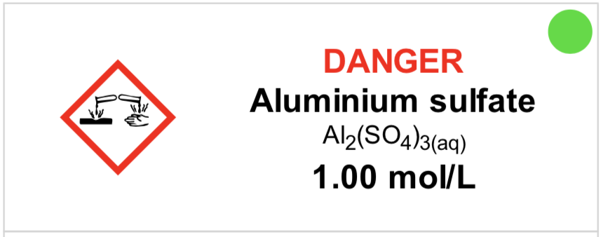
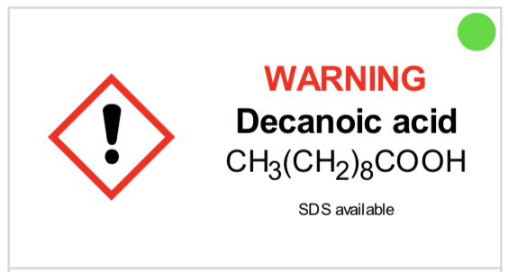
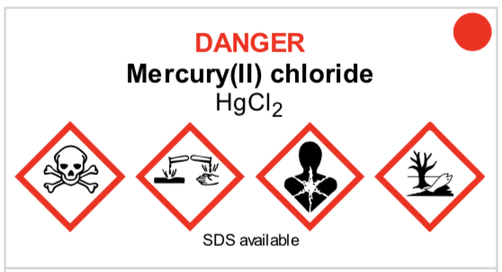
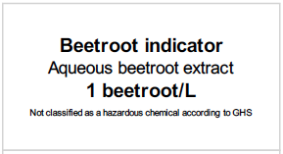
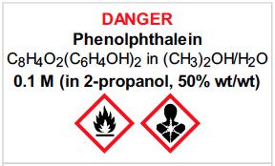

Slide 23
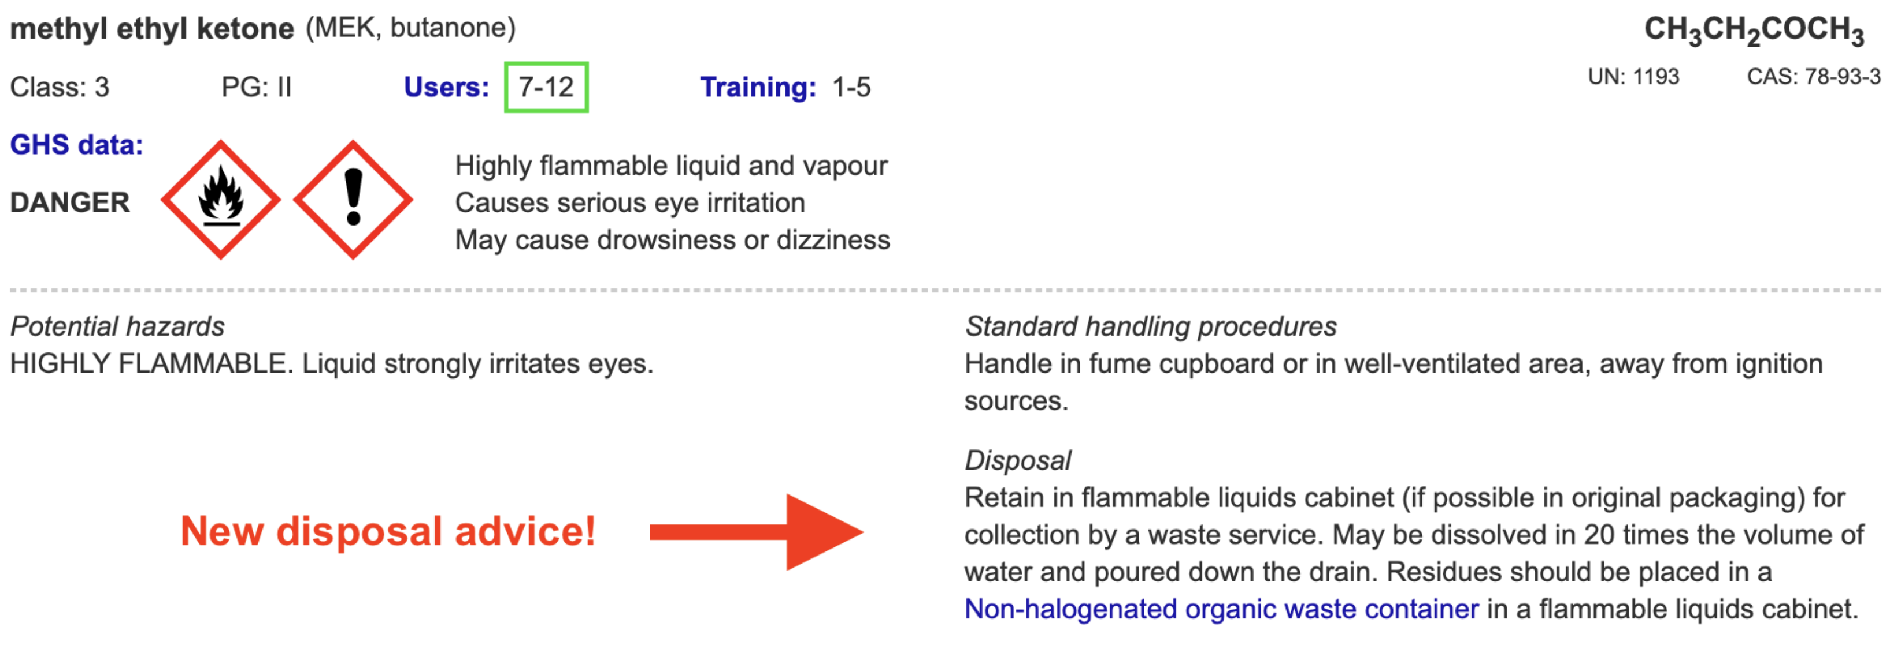
Disposal of chemical wastes
environmentally responsible chemical disposal https://www.riskassess.ca/docs/DisposalOfChemicalWastes.pdf
waste containers
waste container labels

Slide 24
Safety journey
Start
Best practice
Unwanted
chemical
(equipment)
disposal
SDSs
WHMIS
labelling
General
safety
info
Risk assessment
• experiment
Risk assessment
• experiment
+ class + lab
Risk assessment
review + storage
Environmental
waste collection
+ recycling

Slide 25
Future developments
• continually adding new features https://www.riskassess.ca/info/news e.g. chemical waste labels
• planned for 2025: - chemical register/inventory - SDS management system
initially for Science, then extended to whole school

Slide 26
Conclusion
safer science laboratories
legally compliant system for risk assessment
easy-to-use GHS/WHMIS labelling
environmentally responsible waste disposal
extensive safety databases, continually updated
learning resources, staff and students
legal records, institutional memory

Slide 27
DEMO

